Slide 1
Team Cyberpunk Presents:
Tiny Tasks
Cristal Cervantes, Kyle Laxamana, Joseph Paxton, Sagar Patel, Alexis Cruz Aboytes

Slide 2

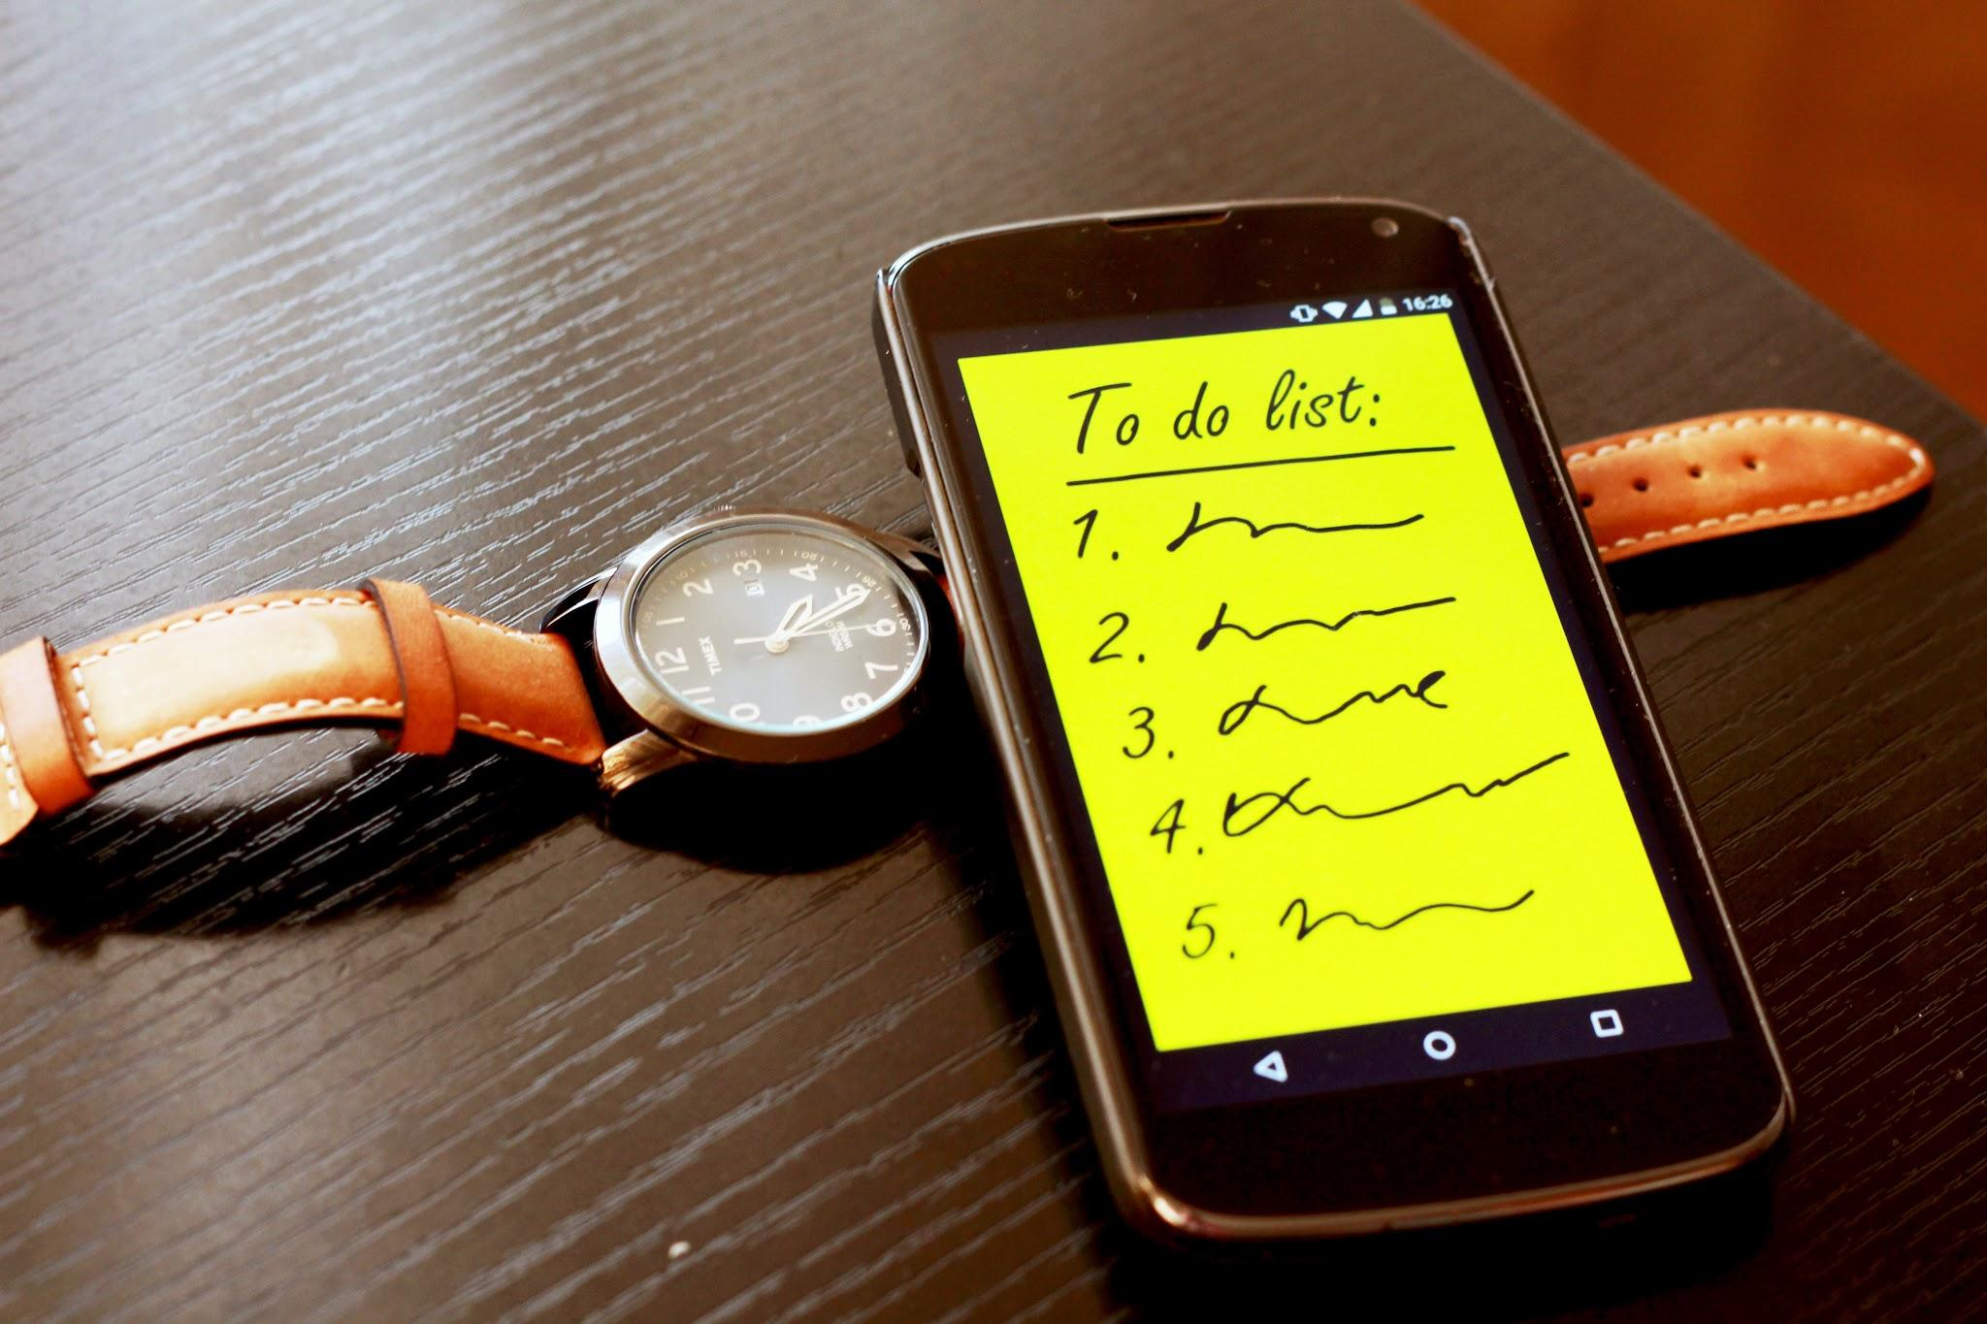

Our proposal
A user-friendly mobile planner and to-do list
Aimed towards the ADHD community
Provide a minimalist and clutter-free experience
Notes:
What’s Tiny Tasks? We’re here to give a helping hand to folks with ADHD. Our mission is to create:
A user-friendly mobile planner and to-do list that helps you stay on top of your tasks and get things done without all the usual clutter and confusion.
Aimed towards the ADHD community, but anyone who wants a simple and effective way to manage their tasks can benefit from our app
Provide a minimalist and clutter-free experience
Specific features:
Timeboxing: You can set aside specific time slots for your tasks, making sure you stay focused.
Task Prioritization: We help you figure out what's most important so you can tackle things in the right order.

Slide 3
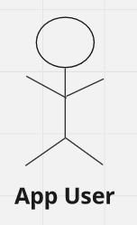
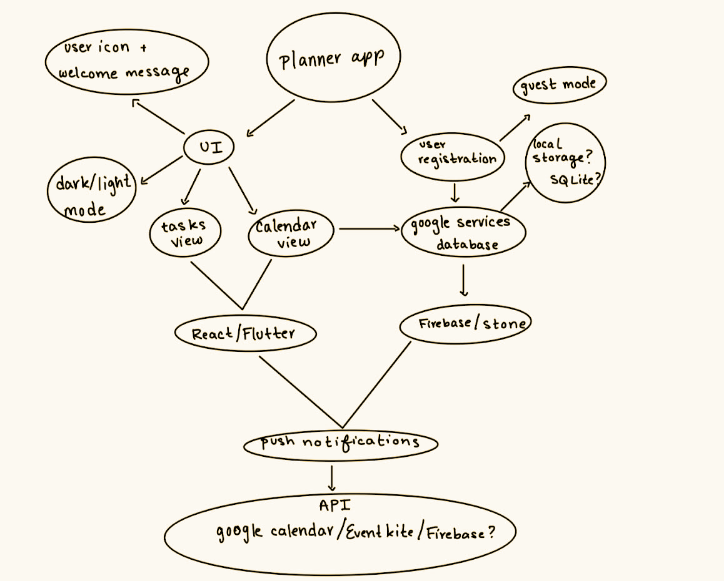
UML Sequence Diagram

Slide 4
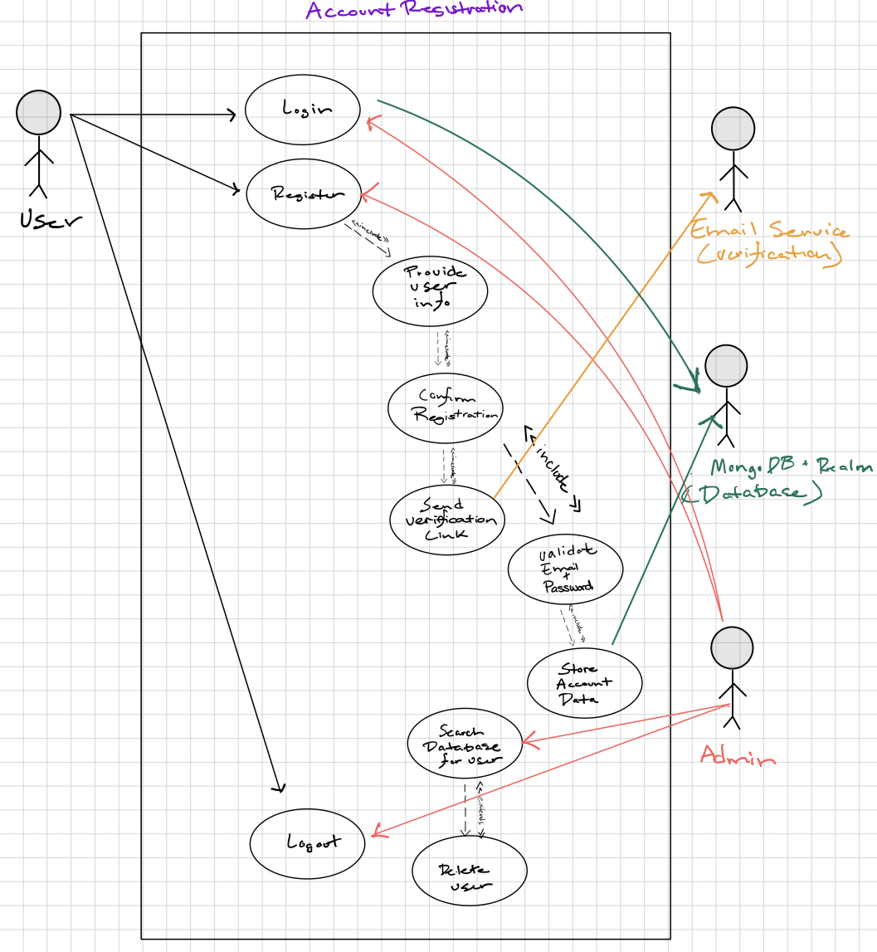
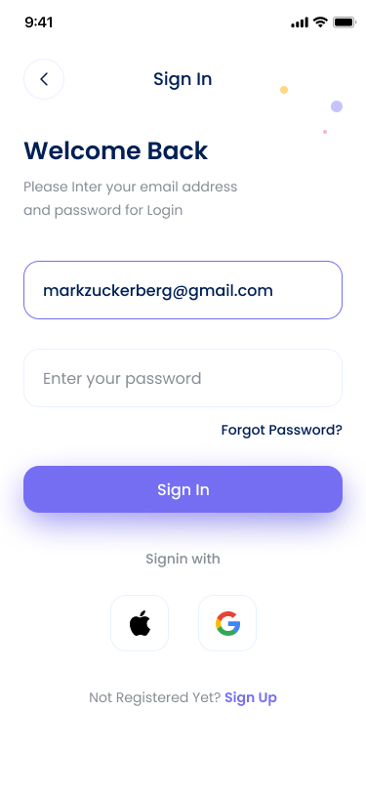
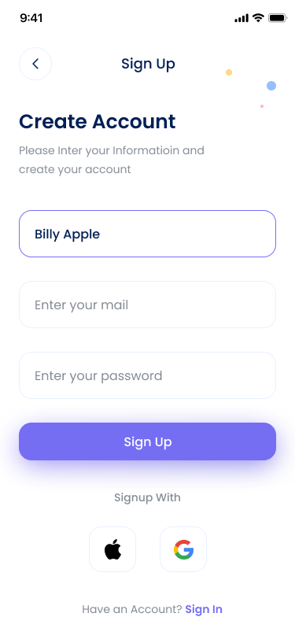
Use Cases Diagram - Account Registration
Mockup designs

Slide 5
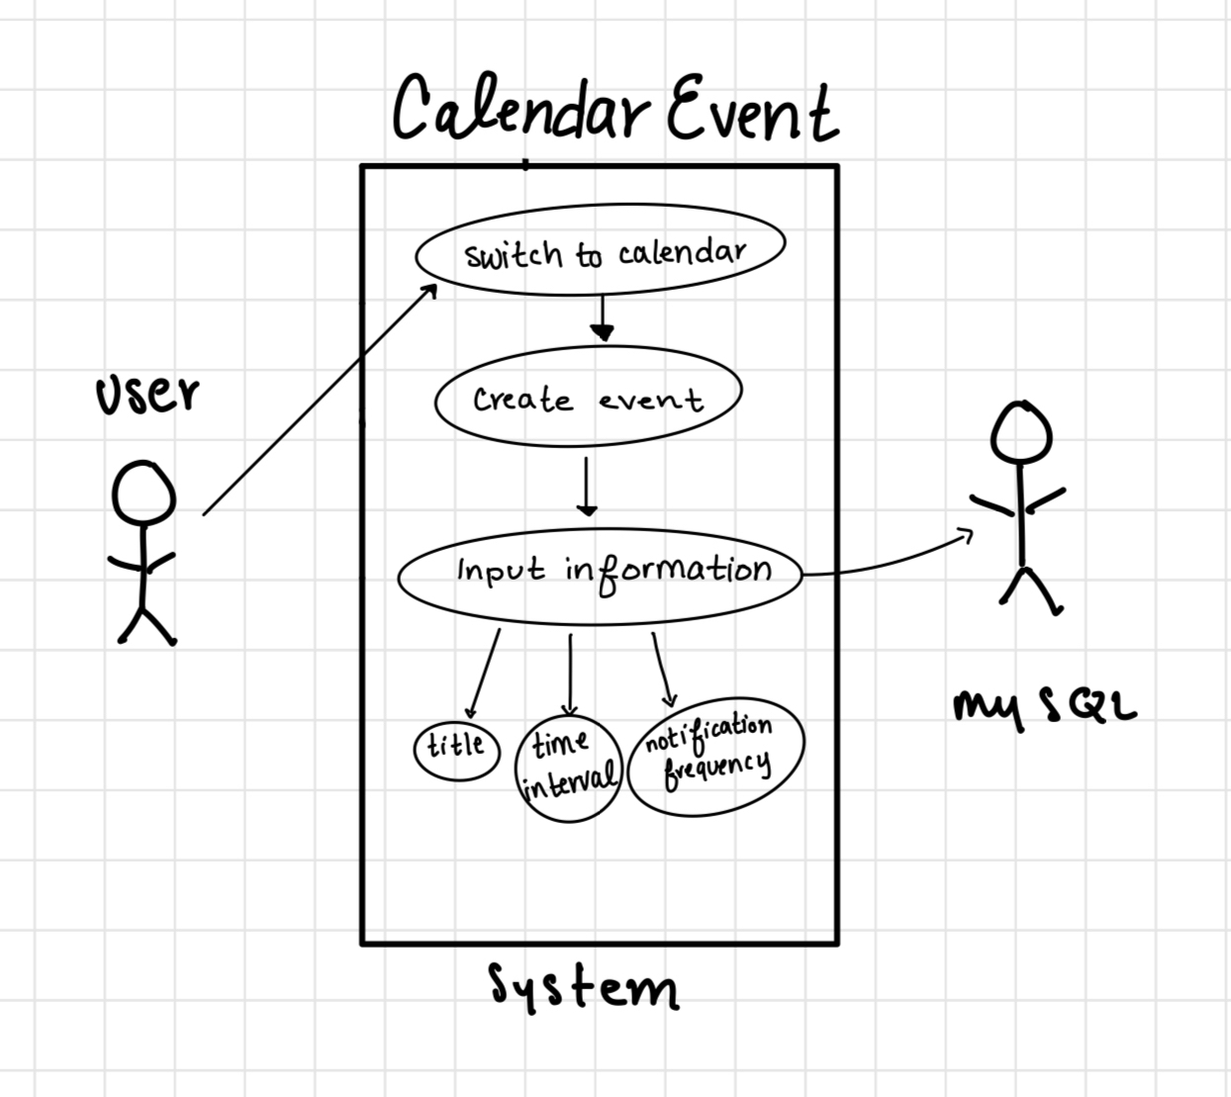
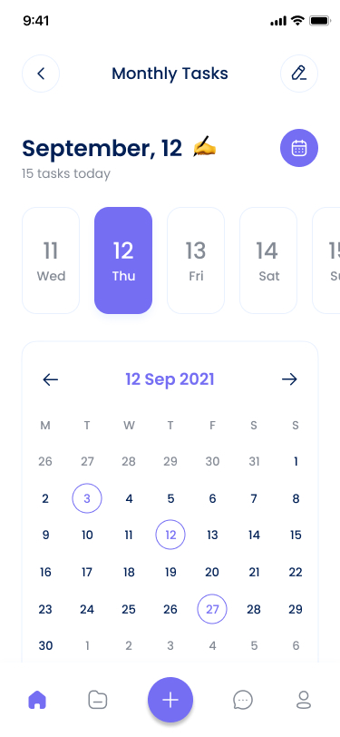
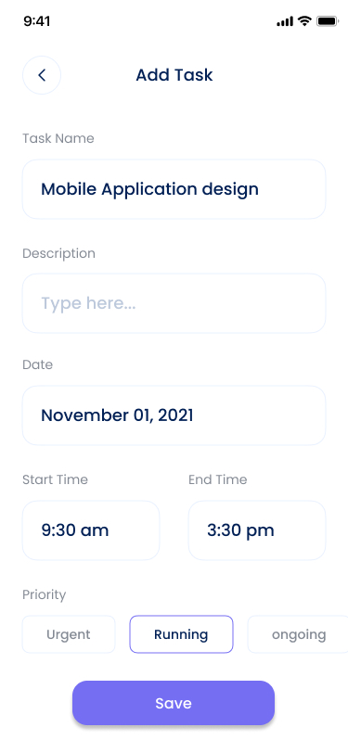
Use Cases Diagram
MongoDB
Mockup designs

Slide 6
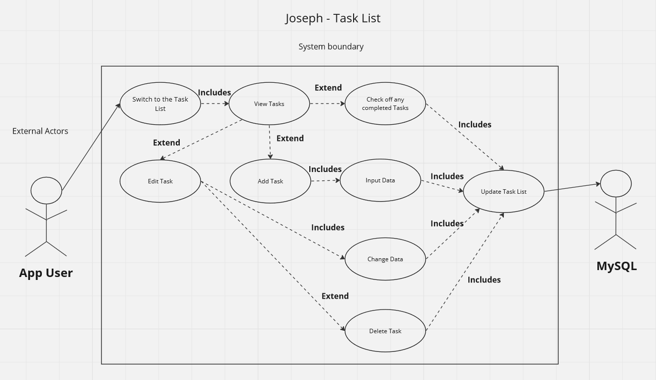
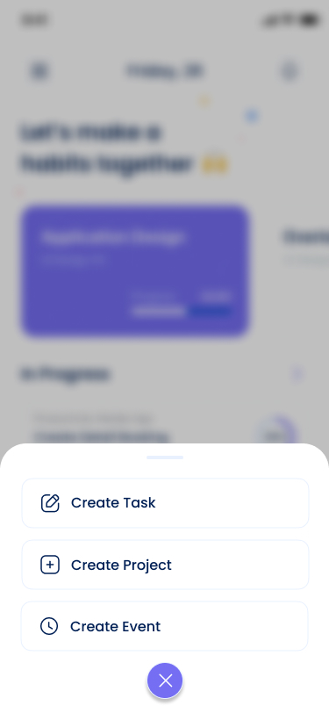
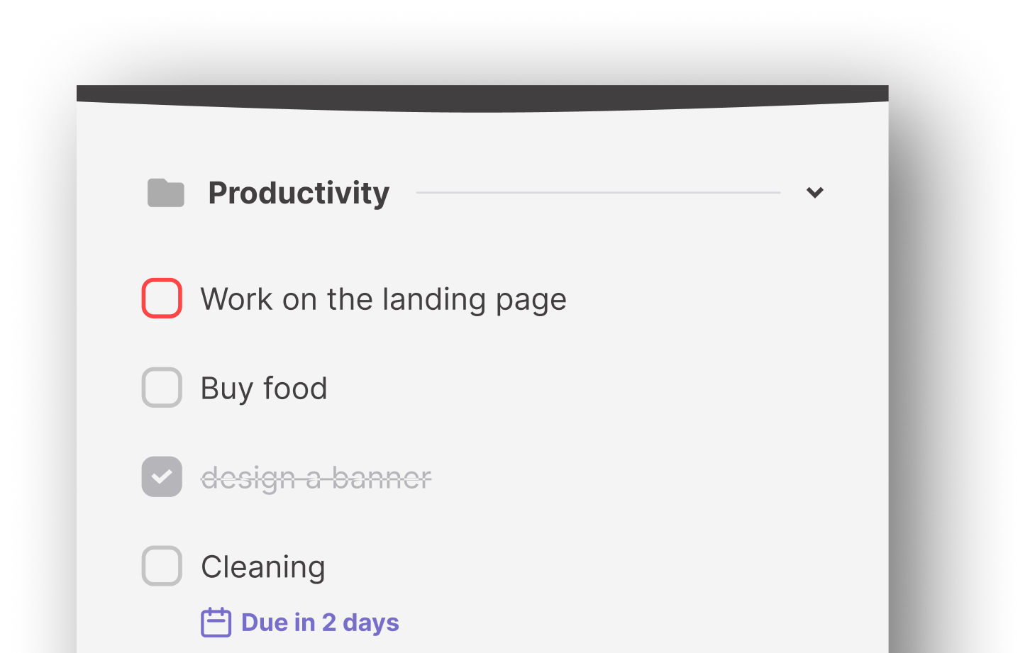
Use Cases Diagram
MongoDB
Mockup designs

Slide 7
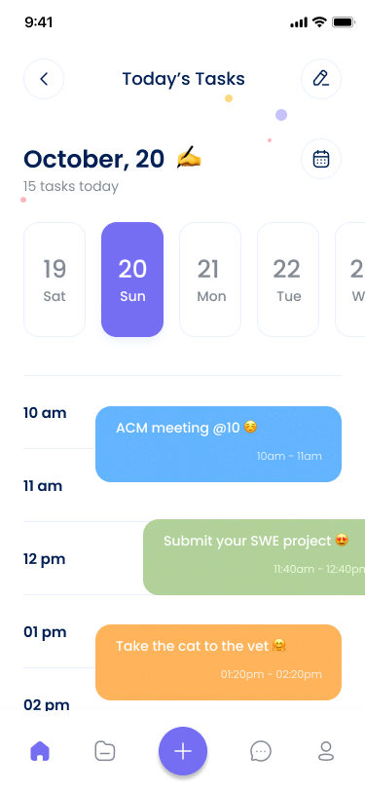
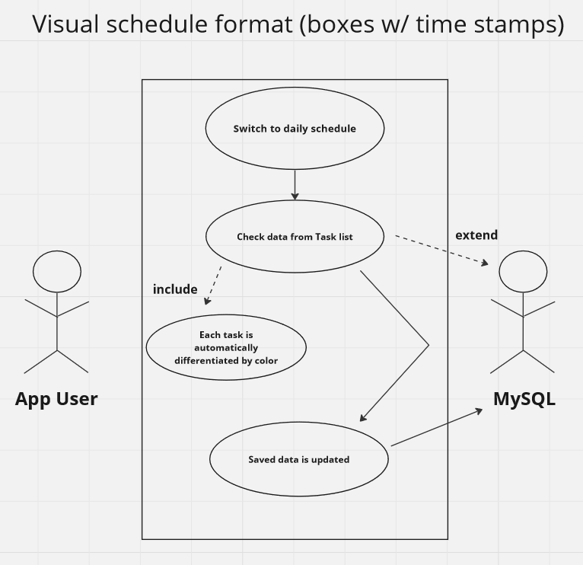
Use Cases Diagram
MongoDB
Mockup

Slide 8
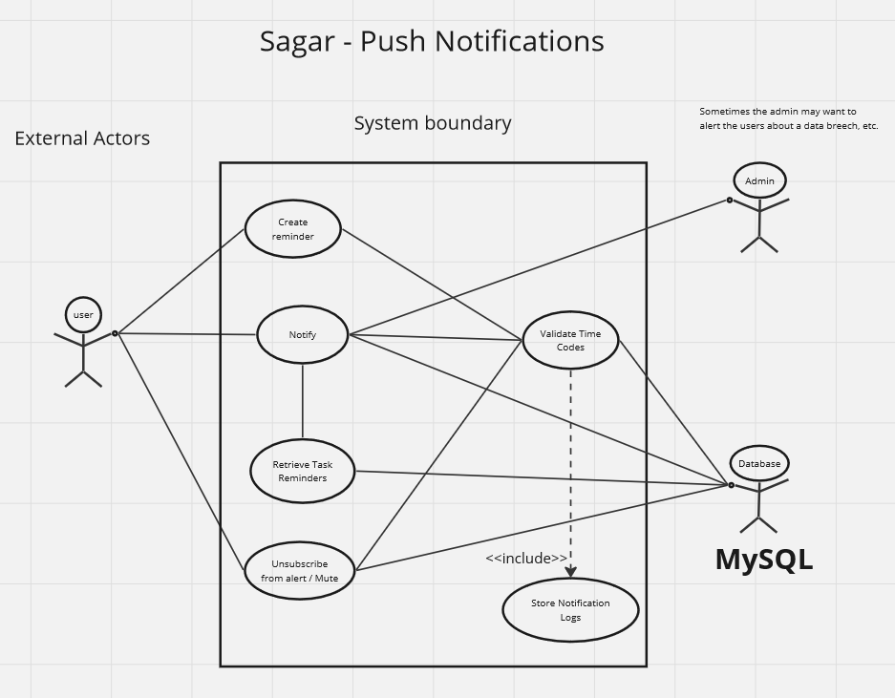
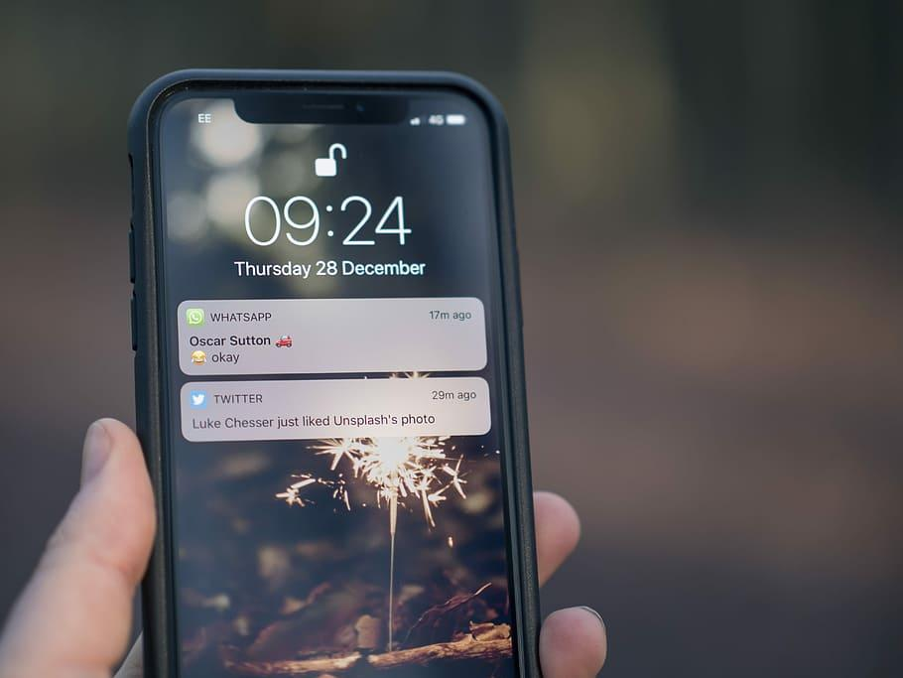
Use Cases Diagram
MongoDB
Notes:
Every reminder has time data associated with it.
We only really need the deadline time code,
but there is also the time and date associated with when the action was made.
We need to validate the time codes because it lets us ensure that notifications are sent at the correct times and according to the user's preferences.
If we have passed the deadline, then we need to issue the push notification and log that the notification has been issued.
We will keep issuing notifications if the current one gets cleared
every time the device restarts, the notifications get cleared, so we need to re-issue one
and users shouldn’t be able to just ignore a notification that they set for themselves
But we also need to make sure we don’t send more than one notification at a time

Slide 9
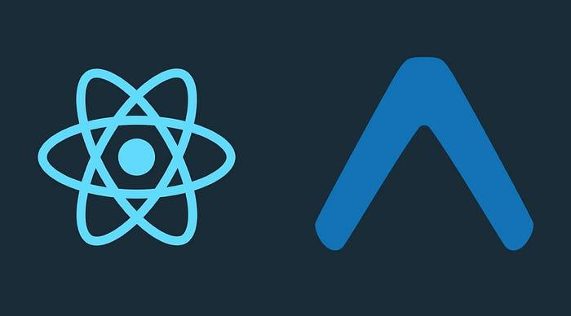
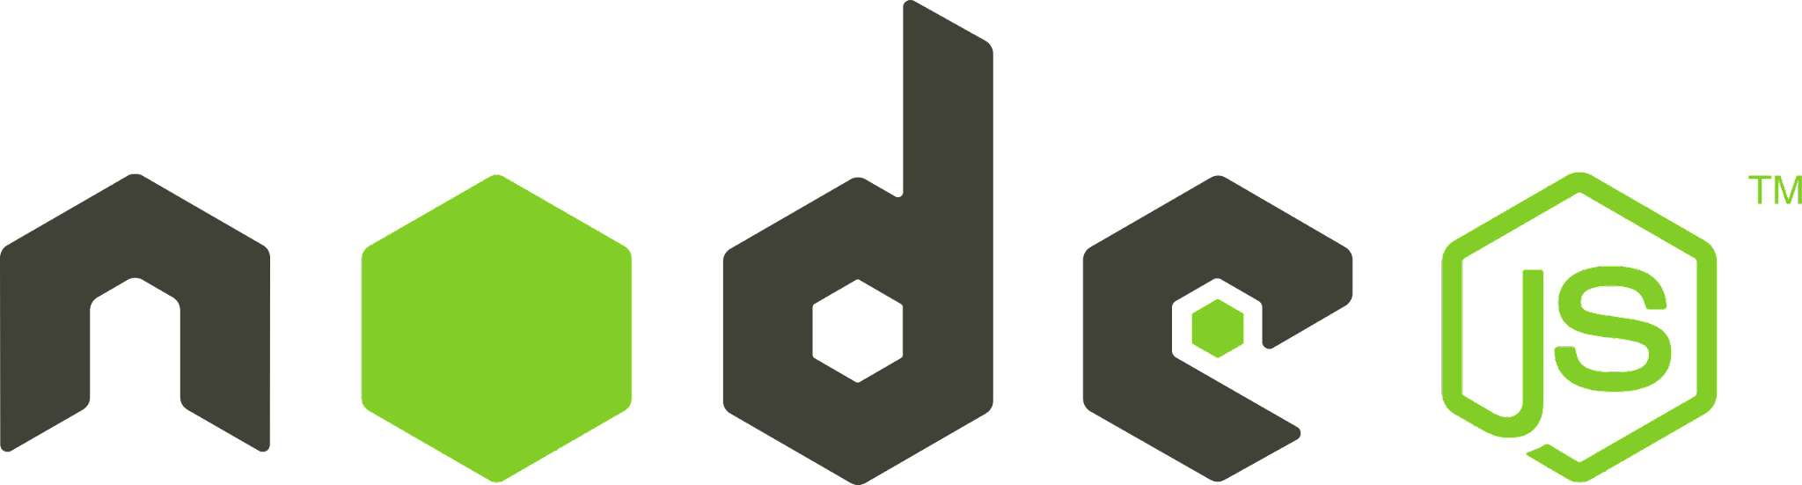

Technical platforms
Frontend: React Native + Expo
Backend: Node.js
Database: MongoDB Realm

Slide 10
Thank you.

